Slide 1

OPERATING SYSTEMS DEADLOCKS
MOHD MAAZ
GU16L0494
M.C.A

Slide 2
What is a deadlock?
It takes money to make money.
You can't get a job without experience; you can't get experience without a job.
Or the below example of bridge

Slide 3
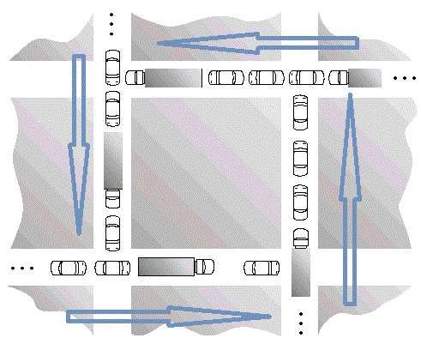
Traffic jam scenario

Slide 4
A deadlock is a situation in which two computer programs sharing the same resource are effectively preventing each other from accessing the resource, resulting in both programs ceasing to function

Slide 5
ALL of these four must happen simultaneously for a deadlock to occur
Mutual exclusion
Hold and Wait
No Preemption
Circular Wait

Slide 6
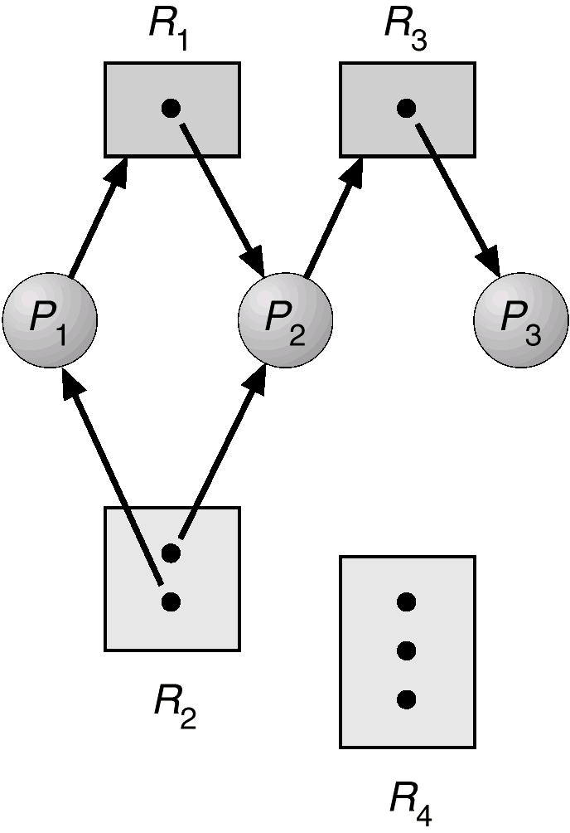
RESOURCE ALLOCATION GRAPH
If the graph contains no cycles, then no process is deadlocked.
R3 Assigned to P3
Resource allocation graph
P2 Requests P3

Slide 7
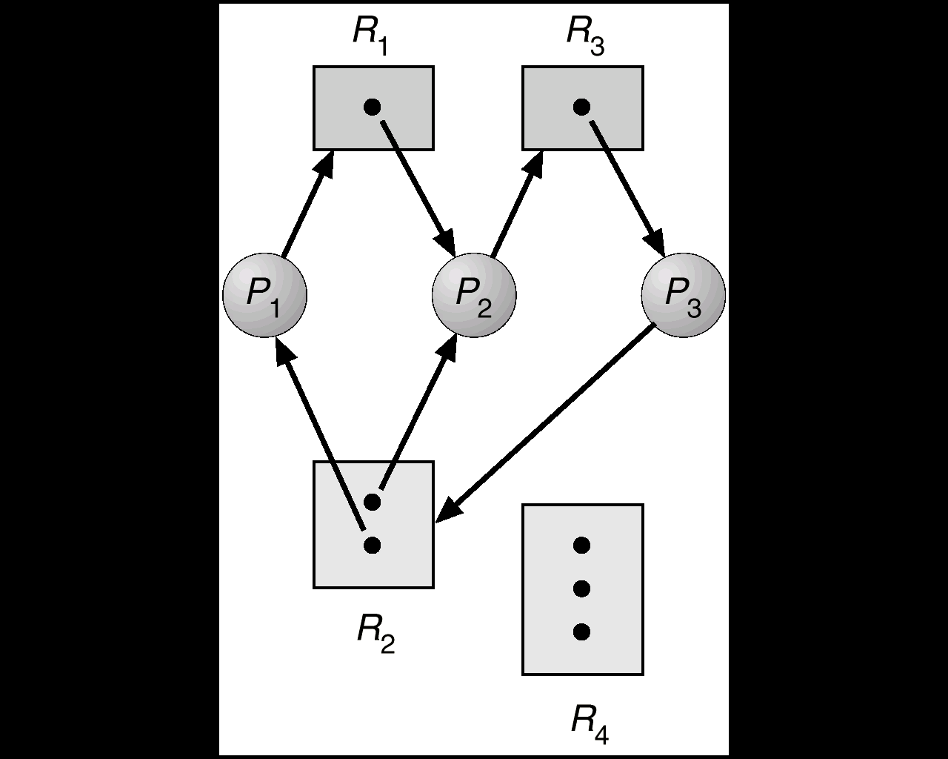
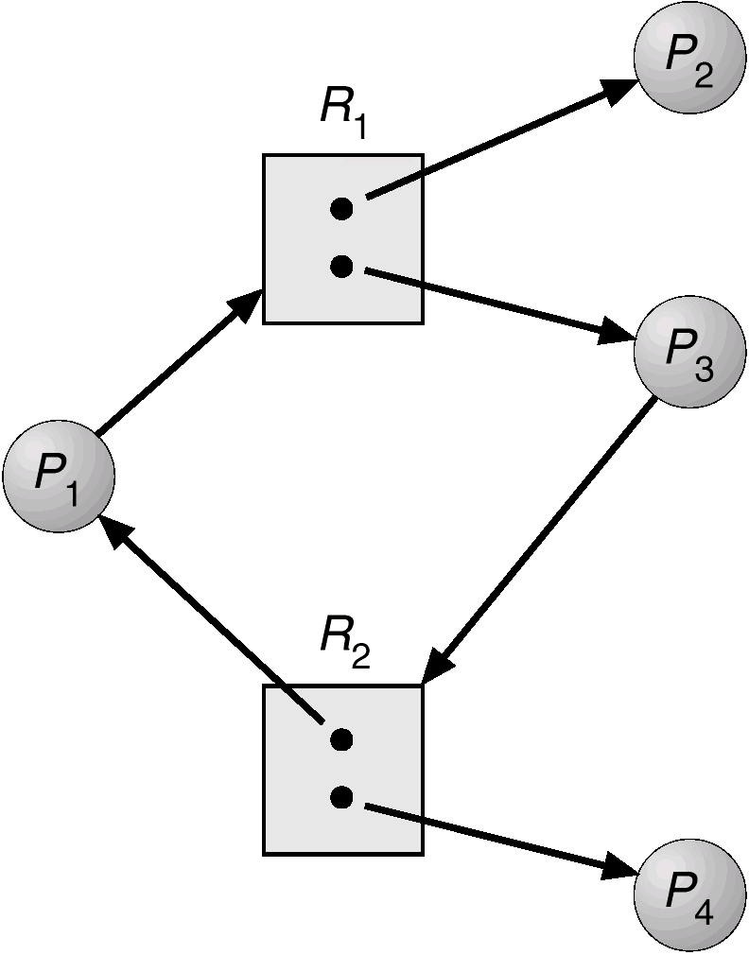
RESOURCE ALLOCATION GRAPH
Resource allocation graph
with a cycle but no deadlock.
Resource allocation graph
with a deadlock.

Slide 8
Deadlock handling
There are three methods:
Ignore Deadlocks:
Prevention
Avoidance

Slide 9
The three states
Deadlock : No forward progress can be made.
Unsafe state :A state that may allow deadlock.
Safe state : A state is safe if a sequence of processes exist such that there are enough resources for the first to finish, and as each finishes and releases its resources there are enough for the next to finish.

Slide 10
The Avoidance of deadlock BANKER’S ALGORITHEM
P - set of processes
Mp - maximal requirement of resources for process p
Cp - current resources allocation process p
A - currently available resources

Slide 11
PESUDO CODE
while (P != ∅)
{ found = False
foreach (p ∈ P)
{ if (Mp − Cp ≤ A)
{ /* p can obtain all it needs. assume it does so, terminates, and releases what it already has.
A = A + Cp
P = P − {p}
found = True }
}
if (!found) return UNSAFE }
return SAFE

Slide 12
REFERNCES
www.letu.edu
https://cs.txstate.edu
https://www.csd.uoc.gr
www.fivedots.coe.psu.ac.th
www.cs.iit.edu
https://en.wikipedia.org
http://www.slideshare.net

Slide 13
THANK YOU…!

